Slide 1
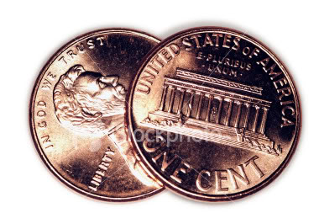
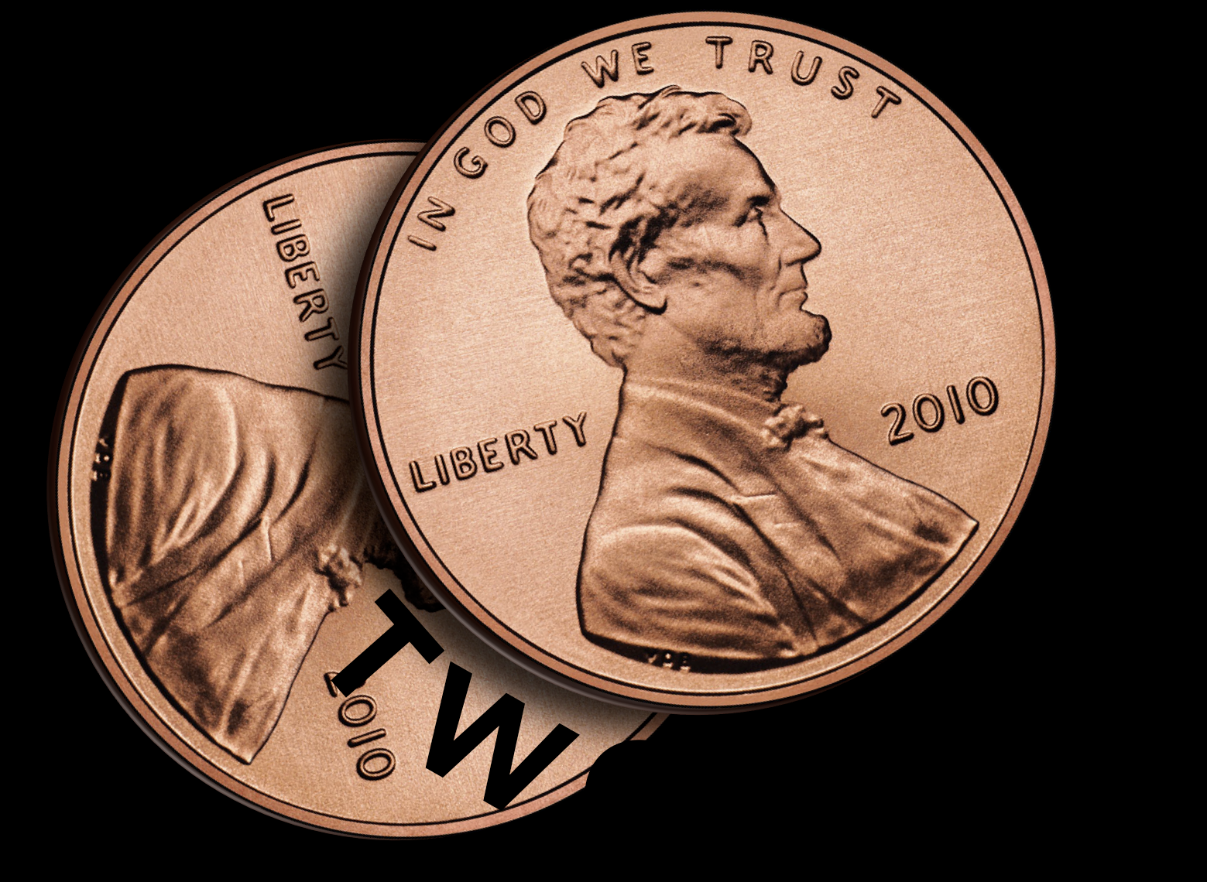
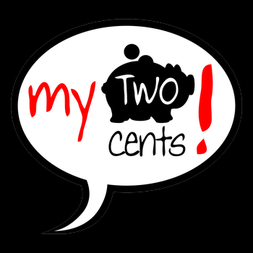
Putting in his 2 cents worth
What does that mean?
"to put your two cents worth in"
to offer your opinion or suggestion, often without being asked for it
to offer your opinion or suggestion, often without being asked for it

Slide 2
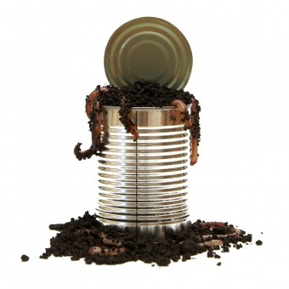
Can of Worms
Is that an idiom?
Yes!!!
What does “open a can of worms really mean?”
Fisherman used to buy sealed metal cans of earthworms, as opposed to the plastic containers or Styrofoam cups of today. After arriving at their fishing spot, they would set the metal can down and open it. What was inside was alive and if the top was left open for too long or the can was tipped over, well, your biggest problem would no longer be catching fish. It would be catching your bait that’s wriggling away.

Slide 3
IDIOM
BREAK THE ICE!
1. To attempt to become friends with someone. He tried to break the ice, but she was a little cold. A nice smile does a lot to break the ice.

Slide 5
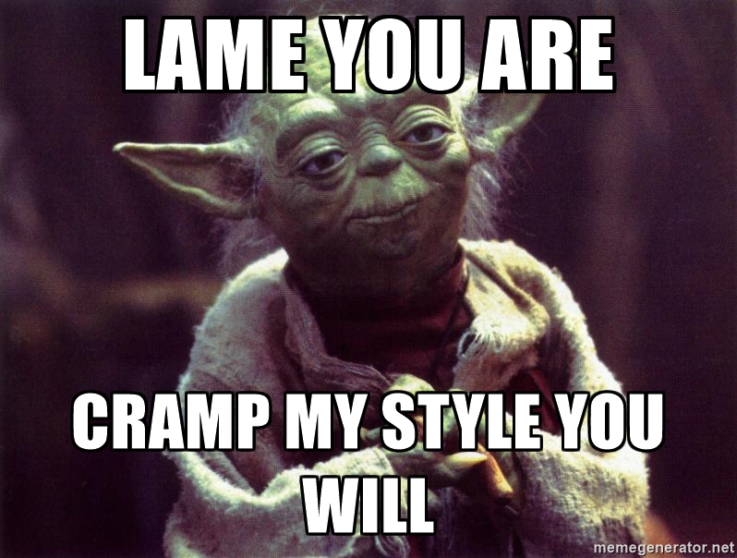
CRAMPS MY STYLE!
The informal idiom "cramp my style" means to restrict or prevent someone from free action or natural expression (in abilities, style, flair, etc).
Dude, you’re cramping my style!

Slide 6
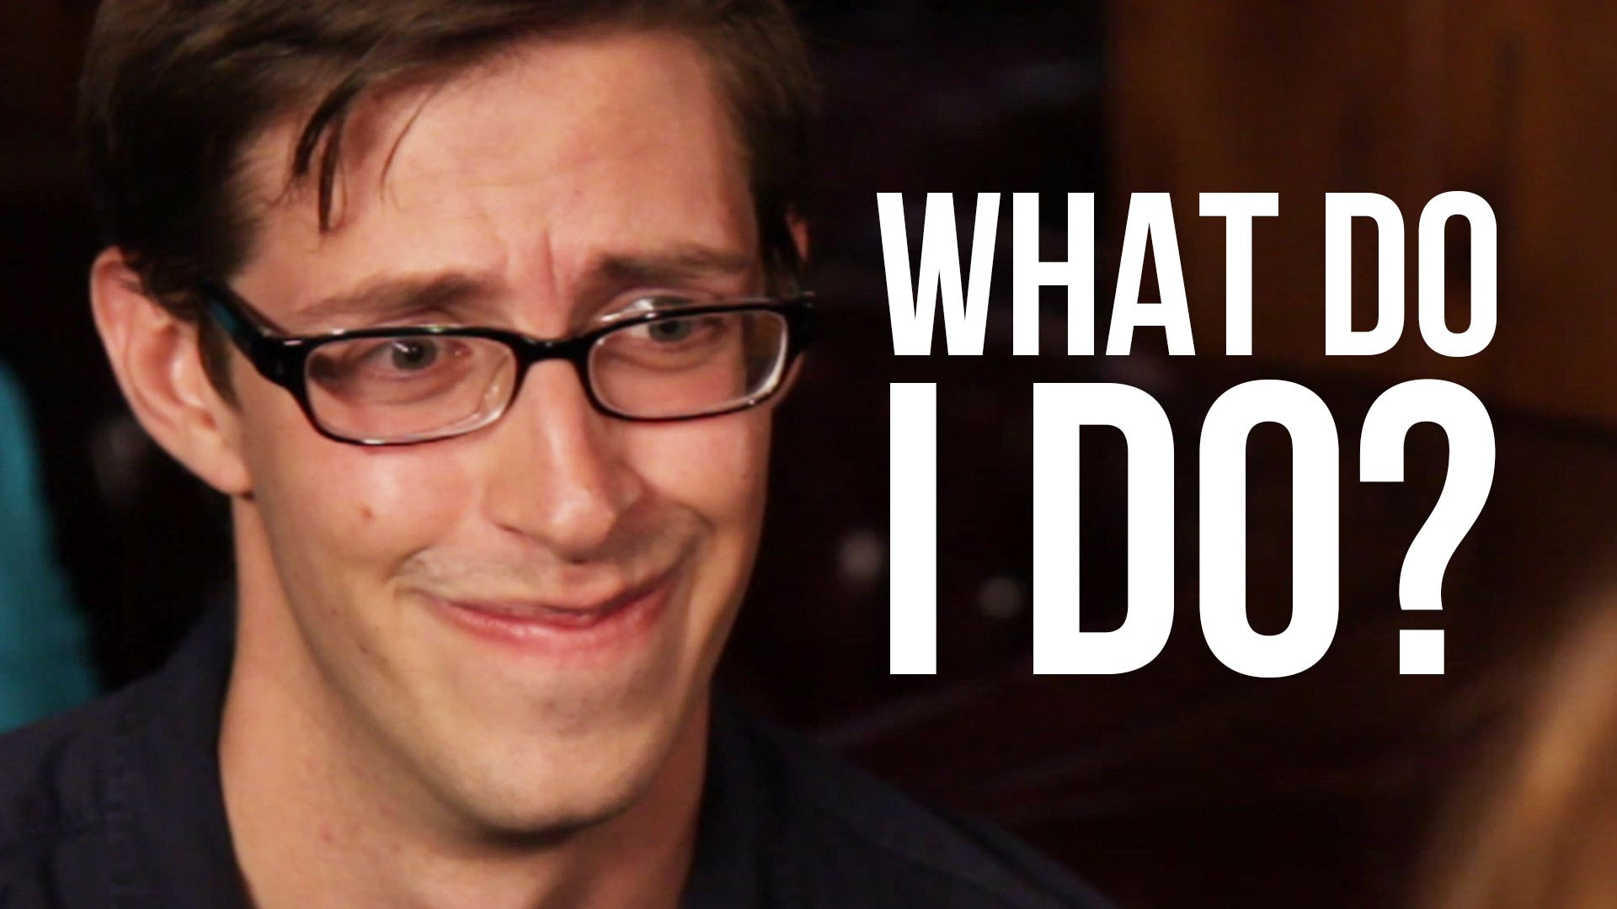
What does the word ‘anxious’ mean?
I am anxious about the spelling test.
The puppy waited anxiously for you to come home.
The robber was anxious. He thought he might get caught stealing the jewels.
experiencing worry, unease, or nervousnes

Slide 7
Dissect the root word of…
When is a convenient time for you to meet?
That time is inconvenient for me.
inconvenience
Convenient

Slide 8
Find the mood of the passage.
What is mood?

Slide 9
mood

Slide 10
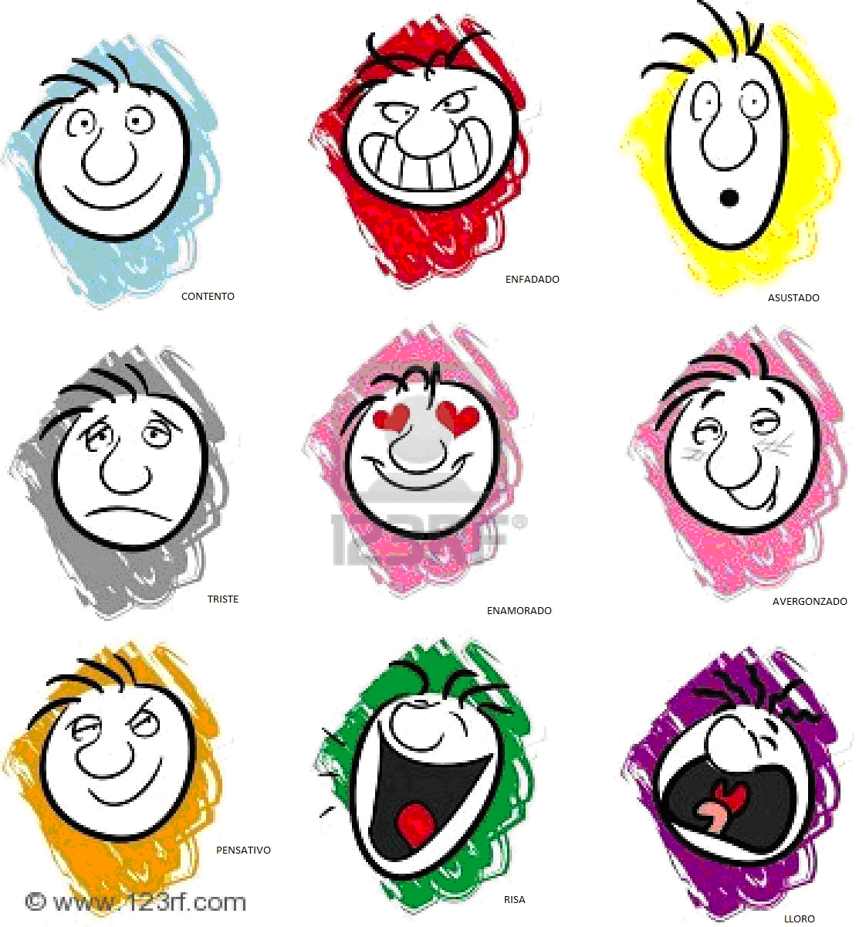
What is your mood?
What mood are the characters of the text in?
Elated? Furious? Anxious? Frightened?

Slide 11
MOOD
What is mood?
1 The atmosphere of a story.
1 The author's attitude towards a topic.
1 How we feel when reading a story.
1 An intense emotion
1 It can be defined as either how we feel when reading a story or the atmosphere.
http://study.com/academy/lesson/understanding-tone-and-mood-in-a-reading-passage.html
WATCH THIS VIDEO.

Slide 13
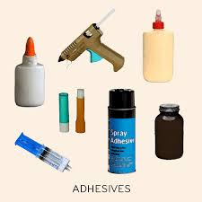
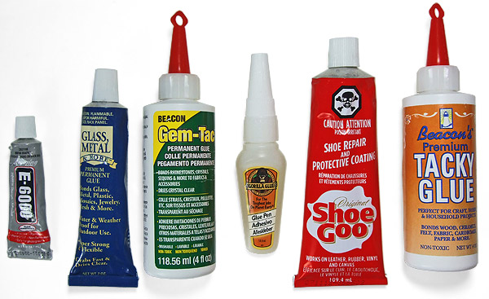
Adhesive
Read the sentence. Select the synonyms.
The adhesive we use in art class keeps our projects together.
Circle the synonyms for the work ‘ADHESIVE’.
Sticky Dull Glue Straight Paste Clingy

Slide 14
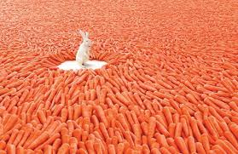
ABUNDANT
She had an abundant amount of chickens at her farm.
present in great quantity; more than adequate; oversufficient:an abundant supply of water.

Slide 15
Ripening
This is a medium-sized, oval, yellowish-red peach of good quality, ripening in September.
Ripe is the root word.
Ripe means having arrived at such a stage of growth or development as to be ready for reaping, gathering, eating, or use, as grain or fruit; completely matured.

Slide 16
Eloquently
eloquently - with eloquence; “He expressed his ideas eloquently: articulately

Slide 17
Solely
Solely is another word for "only" or "entirely“.
Your new puppy is solely your responsibility — you have to feed it, walk it, and take care of it all by yourself.

Slide 18
EMBARGO
Embargo
An embargo is an order stopping the movement of trade ships into or out of a country.
If you can’t get those yummy Swedish fish, perhaps there has been an embargo on trade with Sweden!

Slide 19
atrophy
Atrophy, or withering, in the leg, because it is immobilized and gets no exercise.

Slide 20
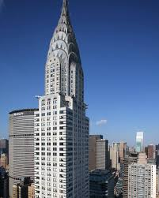
EDIFICE
Edifice means a building, but it doesn't mean just any building. To merit being called an edifice, a building must be important. A mini temple can be an edifice, or a towering sky scraper.

Slide 21
assented
Definition of the root word “assent”:
intransitive verb
to agree to something especially after thoughtful consideration.
Synonym: concur
"Oh yes," assented Princess Mary, "perhaps that's it.

Slide 22
meditated
The root word is meditate. Meditate is defined aa
To think deeply or carefully about (something).
Meditated is past tense of meditate.

Slide 23
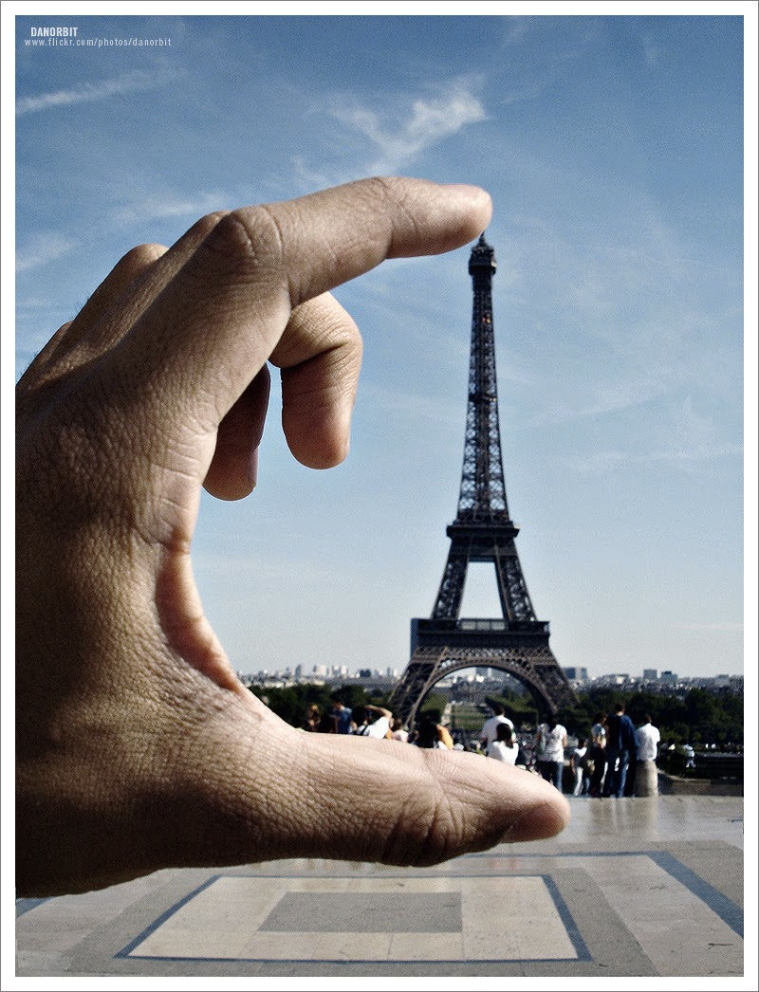
Perspective
Your perspective is the way you see a something. If you think that toys corrupt children's minds, then from your perspective toy shop is an evil place.

Slide 24
Testimonial
Customer Testimonial

